Slide 1
ASP.NET MVC

Slide 2
Introduction to different Web Technology
The ASP Technology
ASP and ASP.NET are server side technologies.
Both technologies enable computer code to be executed by an Internet server.
When a browser requests an ASP or ASP.NET file, the ASP engine reads the file, executes any code in the file, and returns the result to the browser.
Classic ASP - Active Server Pages
ASP (aka Classic ASP) was introduced in 1998 as Microsoft's first server side scripting language.
Classic ASP pages have the file extension .asp and are normally written in VBScript.
Visit our Classic ASP Tutoria
ASP.NET
ASP.NET was released in 2002 as a successor to Classic ASP.
ASP.NET pages have the extension .aspx and are normally written in C# (C sharp).
.

Slide 3
What is ASP.NET MVC
ASP.NET MVC is an open source web development framework from Microsoft that provides a Model View Controller architecture.
ASP.net MVC offers an alternative to ASP.net web forms for building web applications. It is a part of the .Net platform for building, deploying and running web apps. You can develop web apps and website with the help of HTML, CSS, jQuery, Javascript,

Slide 4
MVC Model
MVC Model defines the web application with 3 logic layers
The business layer (Model logic)
The display layer (View logic)
The input control (Controller logic)

Slide 5
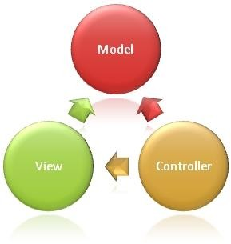
Role of Model, View and Controller
Model
Handles the logic for application data
Retrieves data from the database
View
Handles display of data . Views are created mostly from model data
Controller
Handles User interaction. Read from a View, Control user input and send input data to the model.

Slide 6
How ASP.NET MVC Works Separation Of Concerns
The process of breaking a computer program into distinct features that overlap in functionality as little as possible
Views are presentation form of applications and needs to have no knowledge of the actions coming from Controllers
The Models are business entities
The sole purpose of the Controller is to handle request and it can be independent of the Views and Models
MVC When to Use
High level of control over generated HTML
Separation of Concerns
Highly Testable code base
Suitable for applications done by a large team of developers

Slide 7
Key Benefits of ASP.NET MVC
Full control over your HTML, JavaScript , and URLs
Leverage existing ASP.Net Features
A new presentation option for ASP.Net
A simpler way to program Asp.Net
Clear separation of logic: Model, View, Controller
Test-Driven Development
Support for parallel development

Slide 8
Understanding the structure of an ASP.NET MVC project
The three directories that make the application work
Model
View
Controller
Are there by default(convention)
The Controllers is appended to the name of the Controller
The Views that are tied to Controllers reside in a directory under Views with the Controller name

Slide 9
ASP.NET MVC Architecture

Slide 10
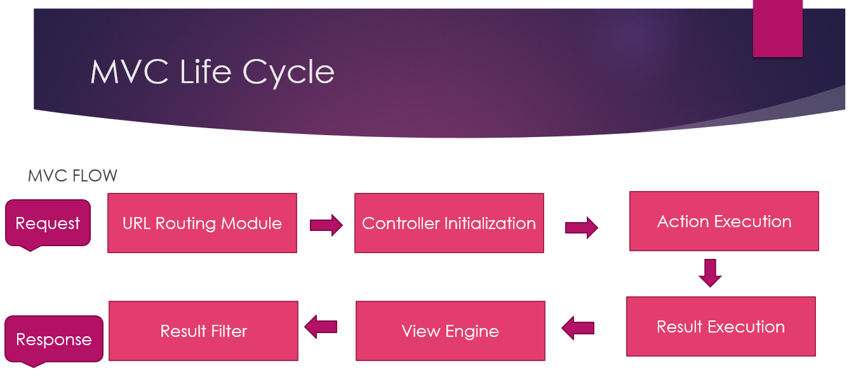
MVC Page Life Cycle

Slide 11
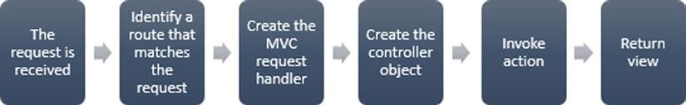
Request Process

Slide 12
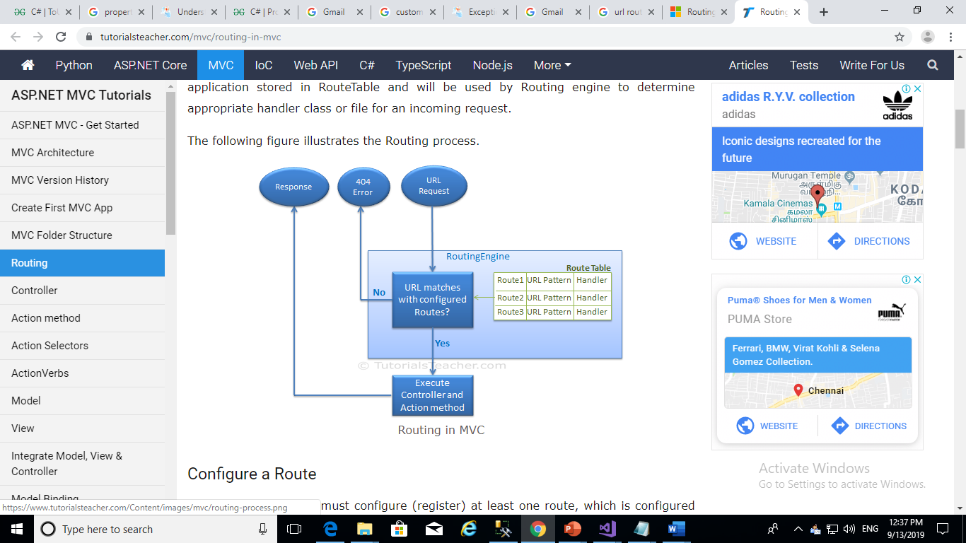
URL Routing
The routing engine using the route map and determines the Controller
It generates a request handler that creates the Controller object

Slide 13
Controller Actions
Controllers process incoming requests using action methods.
Action methods typically have a one-to-one mapping with user interactions. When a user enters a URL into the browser, the MVC application uses routing rules that are defined in the Global.asax file to parse the URL and to determine the path of the controller.
The controller then determines the appropriate action method to handle the request

Slide 14
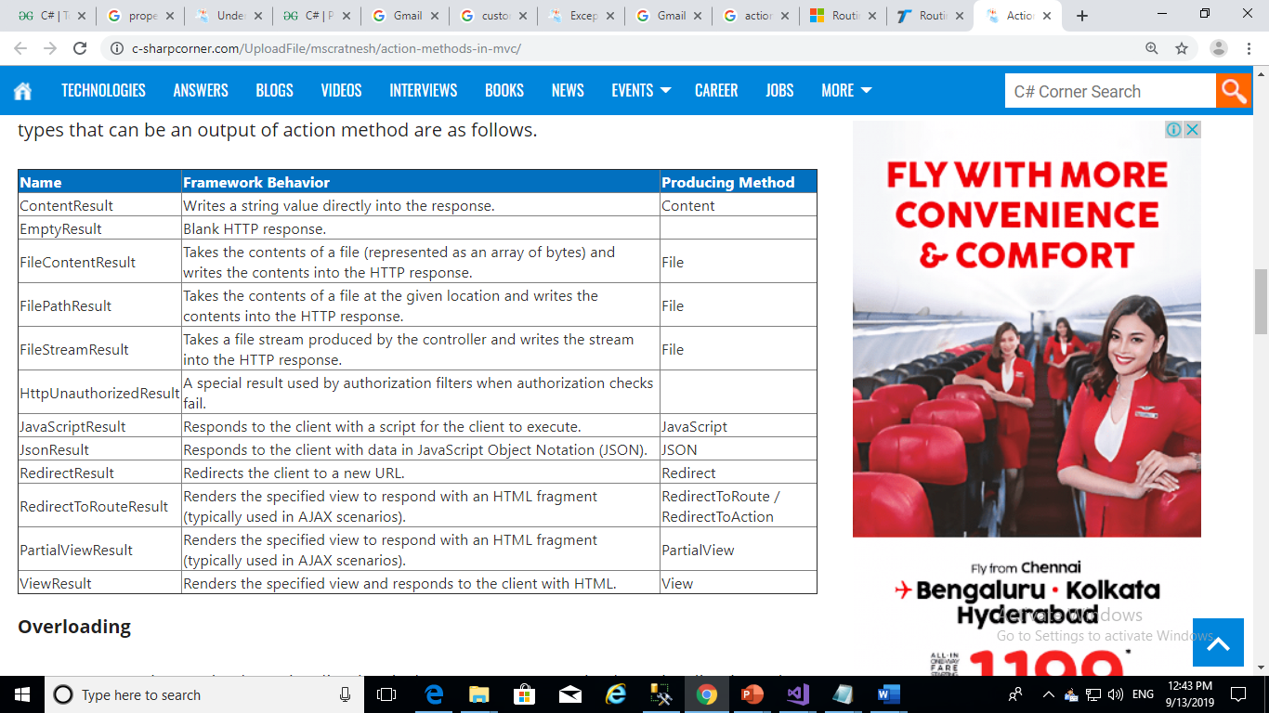
Controller Actions

Slide 15
Razor View Engine
Razor View engine is a markup syntax which helps us to write HTML and server-side code in web pages using C# or VB.NET. It is server-side markup language however it is not at all a programming language.
Razor is a templating engine and ASP.NET MVC has implemented a view engine which allows us to use Razor inside of an MVC application to produce HTML

Slide 16
URL Routing

Slide 17
Introducing URL Patterns
Uniform Resource Locator (URL) is used to identify the unique handler to process incoming request. URL Routing in MVC is a fundamental concept to understand. It defines URL pattern in your MVC application and finds proper handler to process the incoming request.
Creating and Registering a Simple Route
Routing data gets filled in Application_Start event. It uses RouteTable object to fill routes. Route engine uses this table to match incoming request and execute action methods.
You can add route details to application by adding Route object to static Routes property of RouteTable. The Routes property is RouteCollection object.

Slide 18
Defining Default Values
routes.IgnoreRoute("{resource}.axd/{*pathInfo}");
routes.MapRoute(
"Default", // Route name
"{controller}/{action}/{id}", // URL with parameters
new { controller = "Home", action = "Index", id = UrlParameter.Optional } // Parameter defaults
Using Static URL Segments
Not all of the segments in a URL pattern have to be variables – we can also create patterns which have static segments. If we want to match a URL like this: http://mydomain.com/Public/Home/Index
routes.MapRoute(“”, “Public/{controller}/{action}”, new { controller = “Home”, action = “Index” });

Slide 19
Defining Custom Segment Variables
defining our own custom routing mappings in the RouteConfig.cs file
Constraining Routes
Applying the constraints to the any part of URL like Restrict to numeric id only,Controller name with H prefix
Using Attribute Routing
Attribute Routing enables us to define routing on top of the controller action method.
To enable attribute routing:
routes.IgnoreRoute("{resource}.axd/{*pathInfo}"); routes.MapMvcAttributeRoutes();

Slide 20
Generating Outgoing URLs in Views
MVC Framework provides us with a much better approach where we use a URL Routing system to generate and produce URLs dynamically in a way that is guaranteed to reflect the URL schema of the application
public ActionResult Index()
{
ViewBag.Controller = "Simple";
ViewBag.Action = "Index";
return View("DisplayActionController");
}
public ActionResult MySegmentVariable(string id ="MyDefaultIdValue")
{
ViewBag.Controller = "Simple";
ViewBag.Action = "MySegmentVariable";
ViewBag.CustomVariable = id;
return View();
}

